Slide 1

Tourism Management System
by
Mourya

Slide 2

INTRODUCTION
Tour’s And Travel’s
  The Tourism Management System is a web application designed to facilitate the management of various aspects related to tourism.
  It provides functionalities for Users and Admin only.
  Tourists can explore different travel destinations, book tours, and manage their bookings, while administrators can manage destinations, tours, bookings, and user accounts.
  Another functionality is that Guest User who can only just view the page .

Slide 3

objective
  To globalism, organize , standardize and goal of journey towards perfection.
  To make strong relationship with customers so that they can enjoy the holiday of thier dreams.
  Is just an initiative, it will be made to more furthur and developed work of art.

Slide 4

MODULES
Guest User
User
Admin

Slide 5
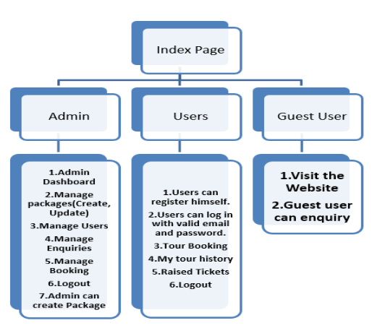

SYSTEM
ARCHITECTURE!

Slide 6



Artemis
Guest User
  Visit the Website - the guest user can visit the website without any registration and login.
  Enquiry -the guest user can enquire how many packages are there and types in that, but he can’t book the package without registration.

Slide 7



User
  Register - User can register himself and login to access the page and do bookings.
  Tour Booking - Users can book the tour within the packages which the admin has created.
  My tour history - users can view their tour history in a table with the booked package details.
  Raised tickets - Here, they can create new tickets by providing relevant information about their issue or request.

Slide 8


Admin
  Create packages - the admin can create packages means, the admin will add the best tour plan for the rate he is given. And he can modify the packages.
  Manage users - the admin can manage the users to activate or deactivate to login.
  Manage enquiries - the admin can view, the user has booked or canceled the package.
  Manage bookings - the admin can view how many users have booked the tickets.

Slide 9

  Manage Raised ticket - Admin can manage the user raised tickets and he can reply to that particular user request.

Slide 10
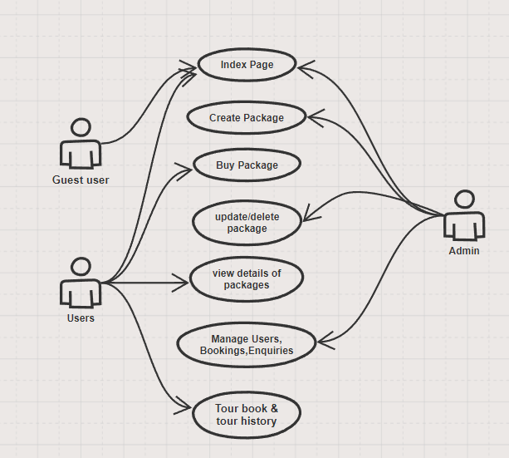

Usecase Diagram

Slide 11
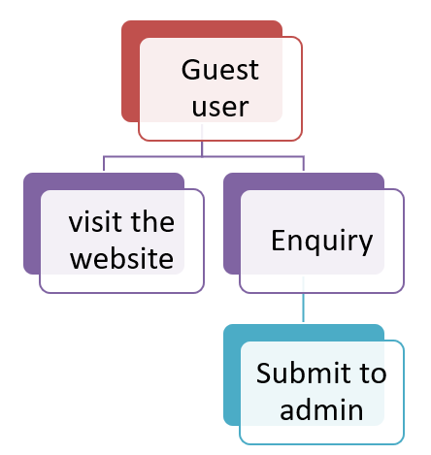
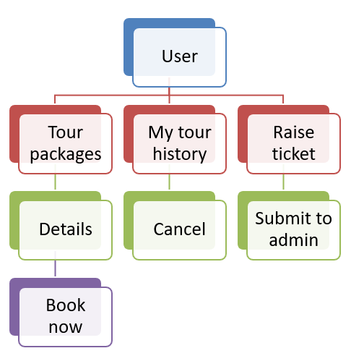
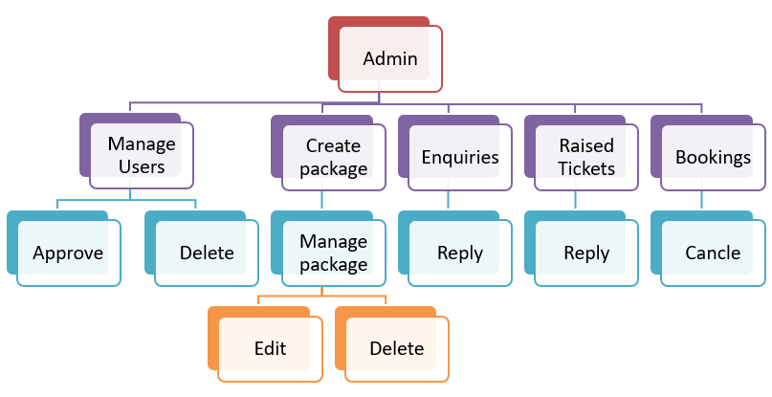

FLOW
DIAGRAMS!

Slide 12

Project
Advantages
  Guest user enquiry
  User raise ticket
  Mind blowing User interface
  Email services

Slide 13

Software requirement And
Specification
  The operating system for the development environment is specified as Microsoft Windows 11.
  For the front-end development, a combination of HTML, CSS, BOOTSTRAP and JAVASCRIPT is chosen to create a dynamic user interface tailored to the needs of the tourism industry.
  On the backend PYTHON coupled with the DJANGO framework, will handle server-side logic and facilitate efficient communication between the client and the database.
  Speaking of the database, DJANGO Database is the chosen relational database management system (RDBMS), ensuring data integrity and scalability necessary for managing diverse tourism-related information. The development environment is primarily supported by Visual Studio Code, a versatile and extensible code editor that provides an efficient platform for writing, debugging, and managing code.

Slide 14

CONCLUSION
  In summary, the tourism management system is the result of strategic planning and diligent execution.
  Through meticulous methodology, we've crafted a robust platform to streamline operations and enhance user experience. From initial stakeholder analysis to final deployment, each step has been meticulously executed.
  The system's launch heralds a new era in tourism technology, promising efficiency and convenience.
  Continuous feedback and refinement ensure its ongoing relevance and effectiveness.
  We're optimistic about its impact on the industry, empowering businesses and travelers a like.

Slide 15
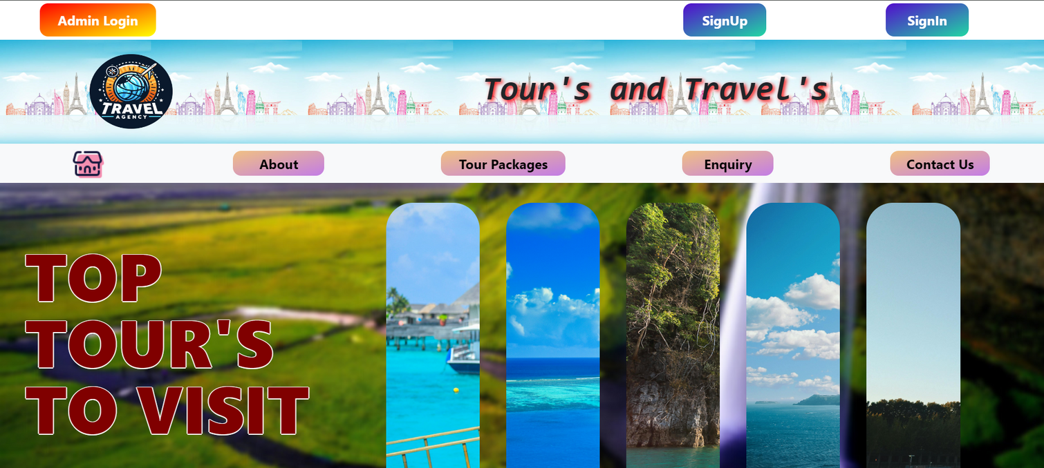
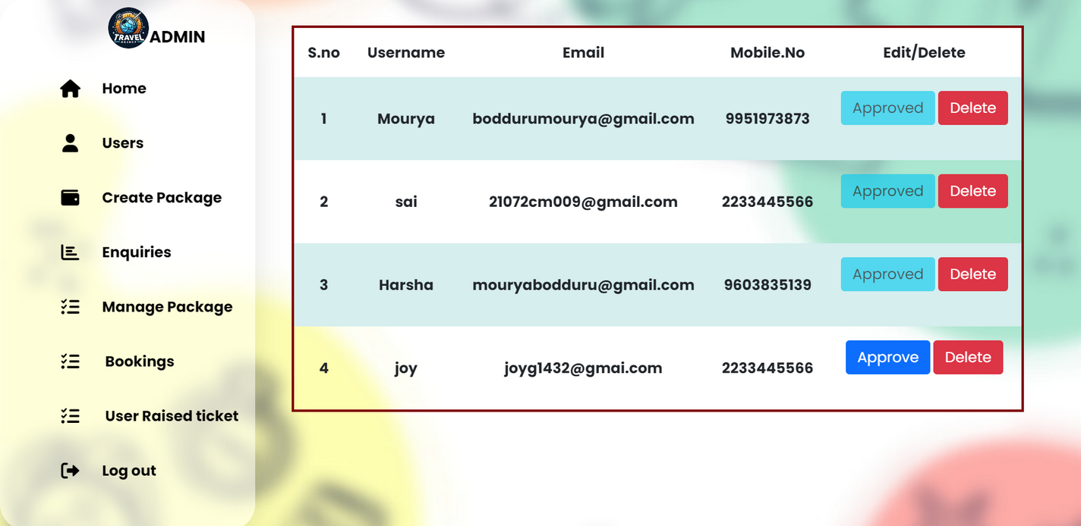
Some
Project
Outcomes

Slide 16
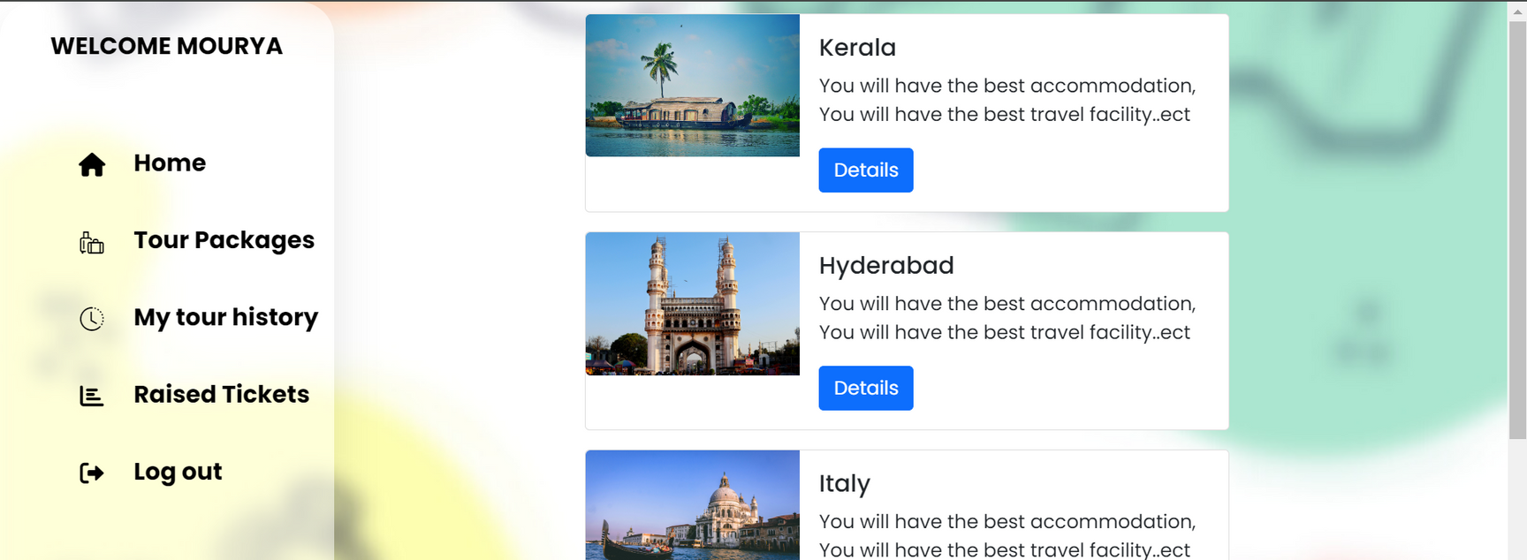
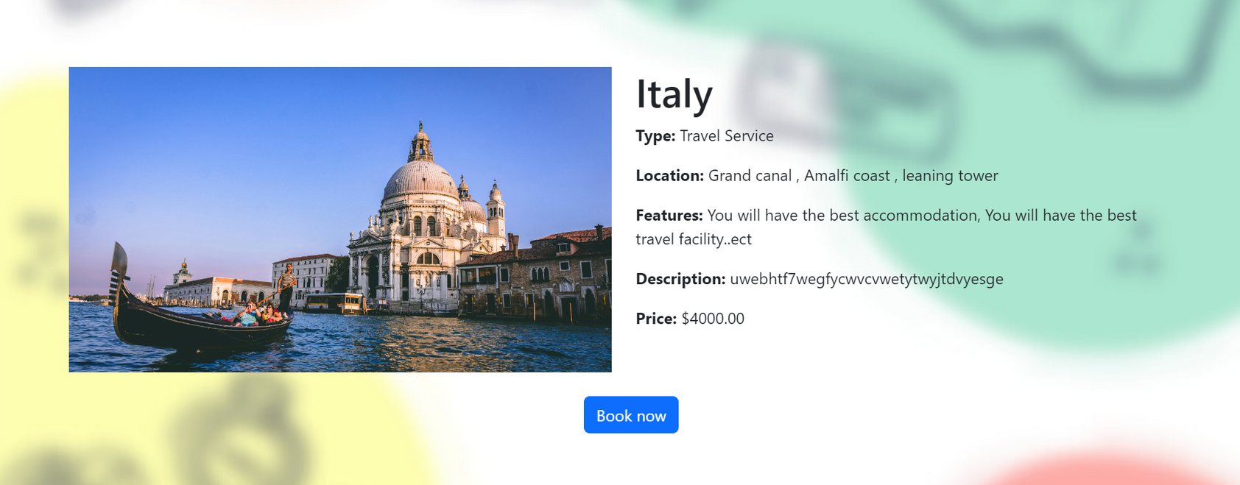
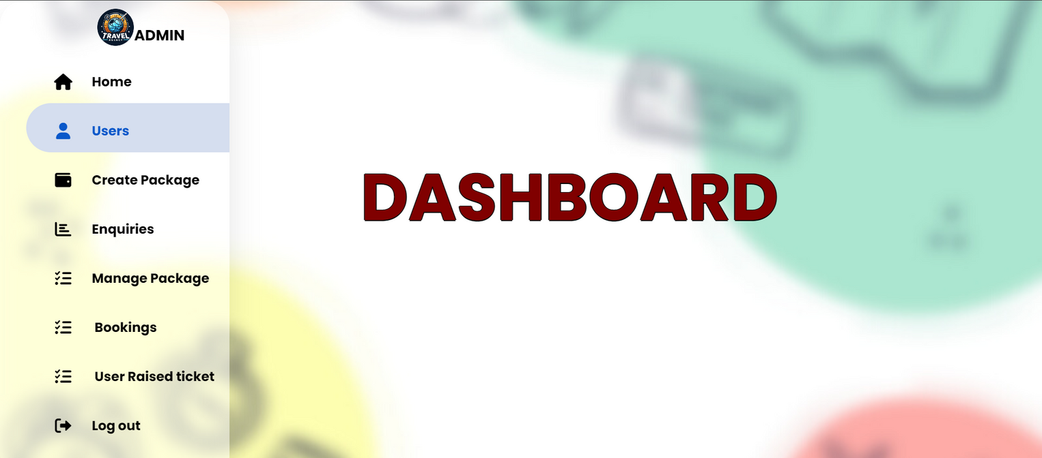
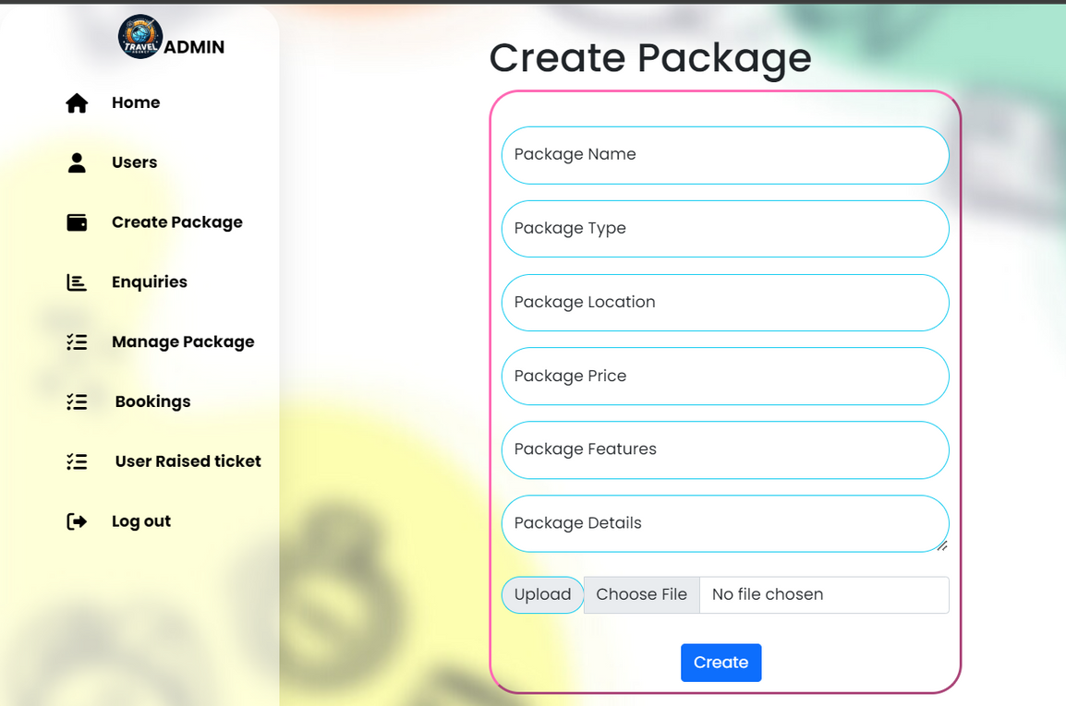

Slide 17

Thank You

